Slide 1
DON’T discuss your answers to these questions with the people around you
What is something that you bought that you really enjoyed (or regretted)?
What is one example of good advice that you have received?
What is one TV show that you liked as a child?
If you could go anywhere in the world, where would you go?

Slide 2
Discuss!
What is something that you bought that you really enjoyed?
What is something that you regret buying?
What is an example of good advice that you received?
What TV show did you like as a child?

Slide 3
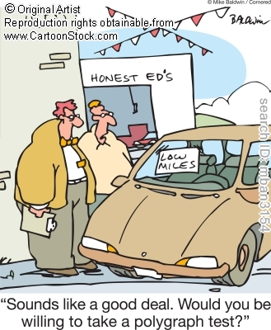
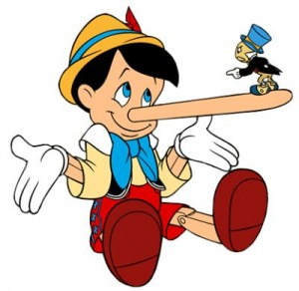
Deception
Lisa Guntzviller
Notes:
Smiling: genuine/fake
Lie to me clip

Slide 4
Thinking about the activity
It is estimated that 1 out of 4 conversations contains an element of deception (Buller & Burgoon)
Are people good at detecting lies in this context?
Why/why not?

Slide 5
Overview
Deception definition
Interpersonal Deception Theory
Definitions of terms
Four-Factor Model
Why you can tell when people are lying
Spotting deception through micro expressions

Slide 6
What is deception?
Definition:
Deception occurs when communicators control the information contained in their messages to convey a meaning that departs from the truth as they know it. This rules out mistaken or unintended lies.
How is it related to persuasion?
All deception is persuasion (Gass & Seiter, 2011)
Persuade someone that you are telling the truth

Slide 7
Interpersonal Deception Theory
Very complex theory
18 main claims/propositions!
Vocabulary
2 of the claims

Slide 8
Types of Deception
Deception Strategies
Falsification- A form of deception that creates a fiction; a lie
Concealment- A form of deception that tells only a portion of the truth
Equivocation- A form of deception that uses vague language to dodge the issue
*These are according to Interpersonal Deception Theory

Slide 9
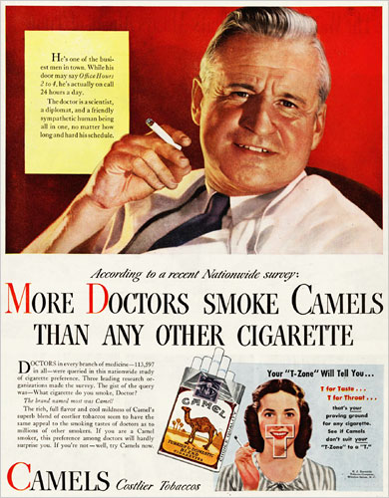
Falsification, Concealment, or Equivocation?
More doctors smoke Camels than any other cigarette
Falsification: creates a fiction; a lie
Concealment: tells only a portion of
the truth
Equivocation: uses vague language
to dodge the issue

Slide 10
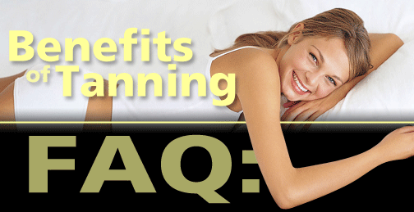
Falsification, Concealment, or Equivocation?
Falsification: creates a fiction; a lie
Concealment: tells only a portion of
the truth
Equivocation: uses vague language
to dodge the issue
Q: Don't UV rays damage the skin?
A: Skin damage is caused primarily by overexposure to UV rays and burning. A healthy tan, on the other hand, helps prevent sunburn.
Notes:
100 percent of dermatologists and 84 percent of non-dermatologist physicians would discourage UV tanning for non-medical purposes, even in healthy patients

Slide 11
Interpersonal Deception Theory
Proposition 2: Deceivers make more strategic moves and leak more nonverbal cues than truth tellers
Proposition 9: Skilled deceivers appear more believable because they make more strategic moves and leak fewer nonverbal cues than unskilled deceivers

Slide 12
Leakage
Def. Behavior outside conscious control that may signal dishonesty
Common leakage cues:
Self-adaptors
Increased blinking and enlarged pupils
Speech errors or hesitations
Higher pitch
Discrepancies between verbal & nonverbal channels

Slide 13
Four-Factor Model
Why people behave differently when lying
Four factors:
physiological arousal
felt emotions
attempted control
cognitive effort

Slide 14
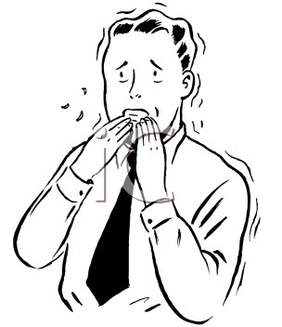
Four-Factor Model
1) Physiological Arousal
People are more anxious or aroused when lying
Are people more or less persuasive when
they are anxious?
Less!
Why?
Because of leakage cues
Speech hesitations
Repeating phrases
More fidgeting

Slide 15
Four-Factor Model
BUT would the situation for the lie change the level of anxiety?
Low consequence lie = minor physiological arousal, minor leakage cues
High consequence lie = high physiological arousal, major leakage cues

Slide 16
Four-Factor Model
2) Different affect/emotions
What emotions are associated with lying?
Negative feelings
Guilt
Deceivers display more negative emotions
However, depends on the situation
Some people enjoy lying!
Sometimes people don’t feel bad on about lying

Slide 17
Four-Factor Model
3) Control their behavior
Because people don’t want to get caught lying
Both before and during deception
For example, try to appear calm
Sending Capacity Hypothesis
When people try to control behavior, they pay more attention to some behaviors and less attention to others
What do we look for as cues that someone is lying?
Facial expressions, eye contact
People tend to pay less attention to fidgeting with the body (e.g., tapping foot) and to vocal pitch

Slide 18
Four-Factor Model
4) Cognitive factors
Lying requires more brain power than telling the truth
You have to come up with a story on the spot
You have to remember your story
Monitoring the other person’s feedback

Slide 19
Lies: More or Less Persuasive
Lies are more difficult to tell when…
They are spontaneous (rather than planned)
The consequences of getting caught are greater
They are longer
The person is emotional

Slide 20
Criticism of IDT and Four-Factor Model
Models assume that lying requires more cognitive effort and creates anxiety
BUT there may be cases where this isn’t true
Think of “white lies”
Sometimes it may be easier to tell a white lie than to come up with a tactful way to tell the truth

Slide 21
One type of leakage: Micro-expressions

Slide 22
Lie to Me
TV Show
Based on work by Dr. Paul Ekman
Psychologist who came up with the concept of microexpressions
Acts as a consultant to the show
Notes:
Season 1, episode 1: From beginning to 3:55

Slide 23
Lie to Me
What is/isn’t real about the show
90% of information factual
Coaches actors on facial expressions
Overly quick, decisive
People who are natural face-readers
Less than 1% of population
He used them often in his research

Slide 24
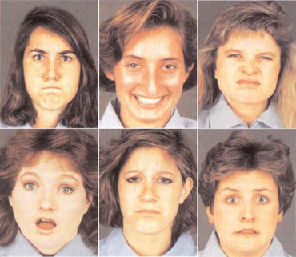
6.5 Universal Emotions
Notes:
Anger, Happiness, Disgust, Surprise, Sadness, Fear

Slide 25
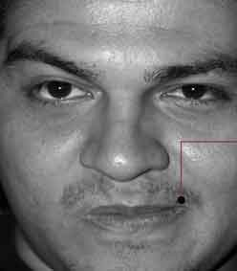
Contempt – added later

Slide 26
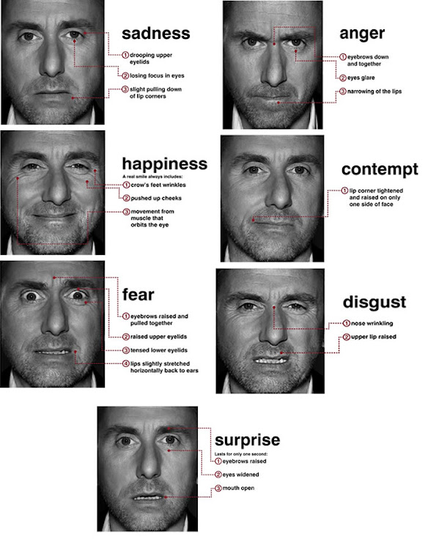

Slide 28
Micro-Expressions
Test Yourself!
http://www.cio.com/article/facial-expressions-test

Slide 29
Micro-Expressions
How realistic is the test?
What do micro-expressions tell you about someone who might be lying?
Do they tell you if that person is lying or not?

Slide 30
One type of micro-expression: Happiness
Genuine smiling = halo effect
Friendliness
Kindness
Altruism
Godoy et al., 2005
Women report using more fake smiling than men, and use it to mask negative emotions
Woodzicka, 2008

Slide 31
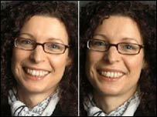
Fake vs. Genuine Smile
About the test
1 or 2 second video clip of a person starting and ending a smile
Taken from conversations
Can only watch the video once
http://www.bbc.co.uk/science/humanbody/mind/surveys/smiles/

Slide 32
Genuine Smile
Automatic Response
Watch corner of eyes
Wrinkles appear
Eyes crease, sometimes become narrower
Eyebrow movement

Slide 33
Take-Away Points
How is deception related to persuasion
Definitions of key terms
E.g., deception, leakage, falsification
Components of Four-Factor Model
What are micro-expressions?
How to tell a genuine smile from a fake smile

